Slide 1
Modern Technology
Automation Nation

Slide 2
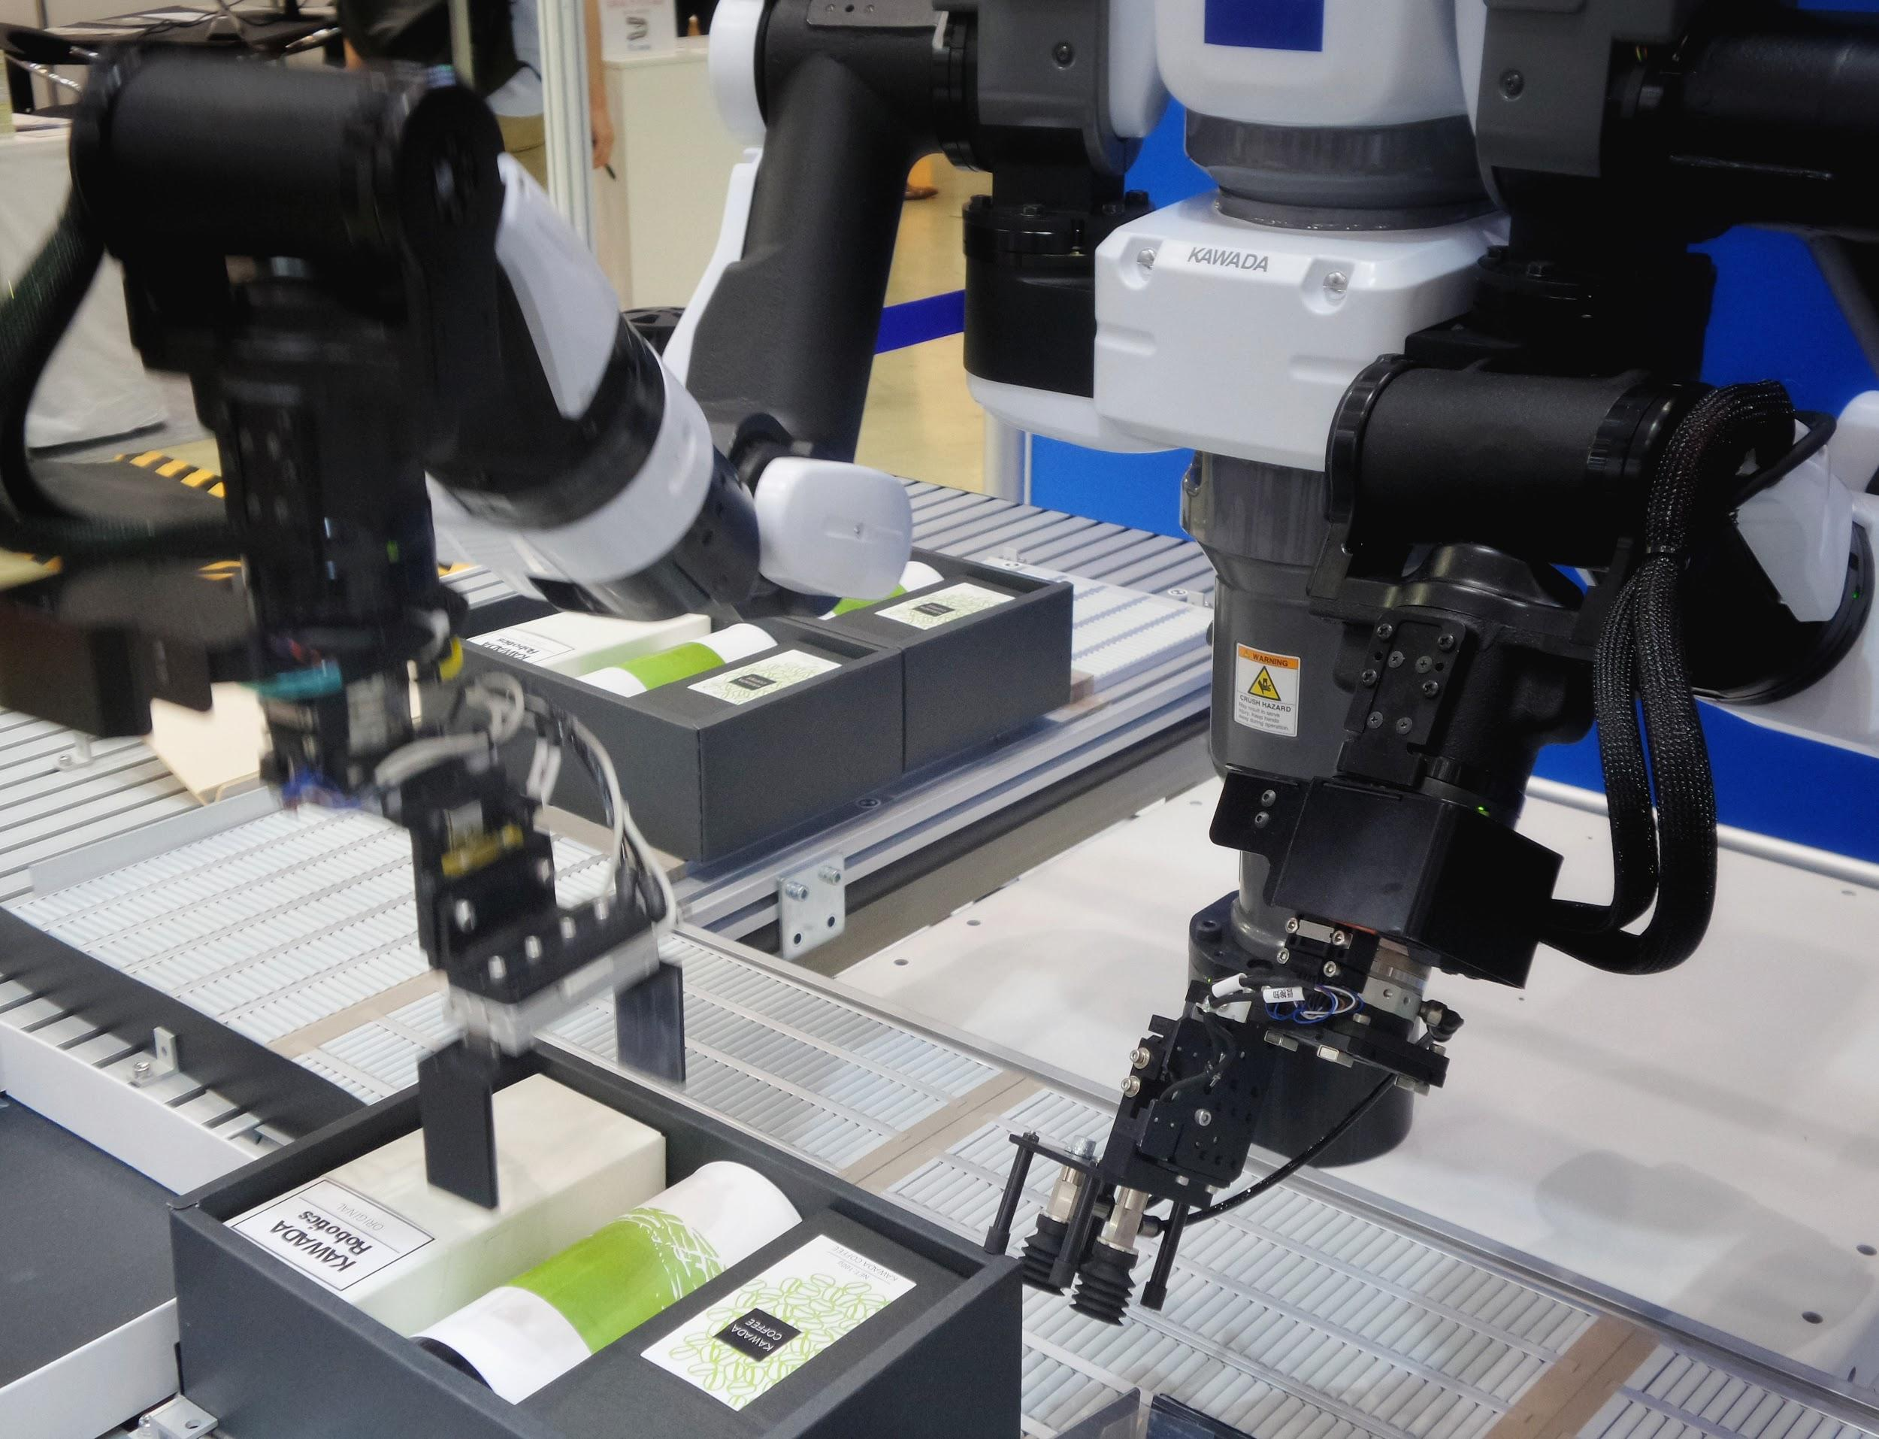
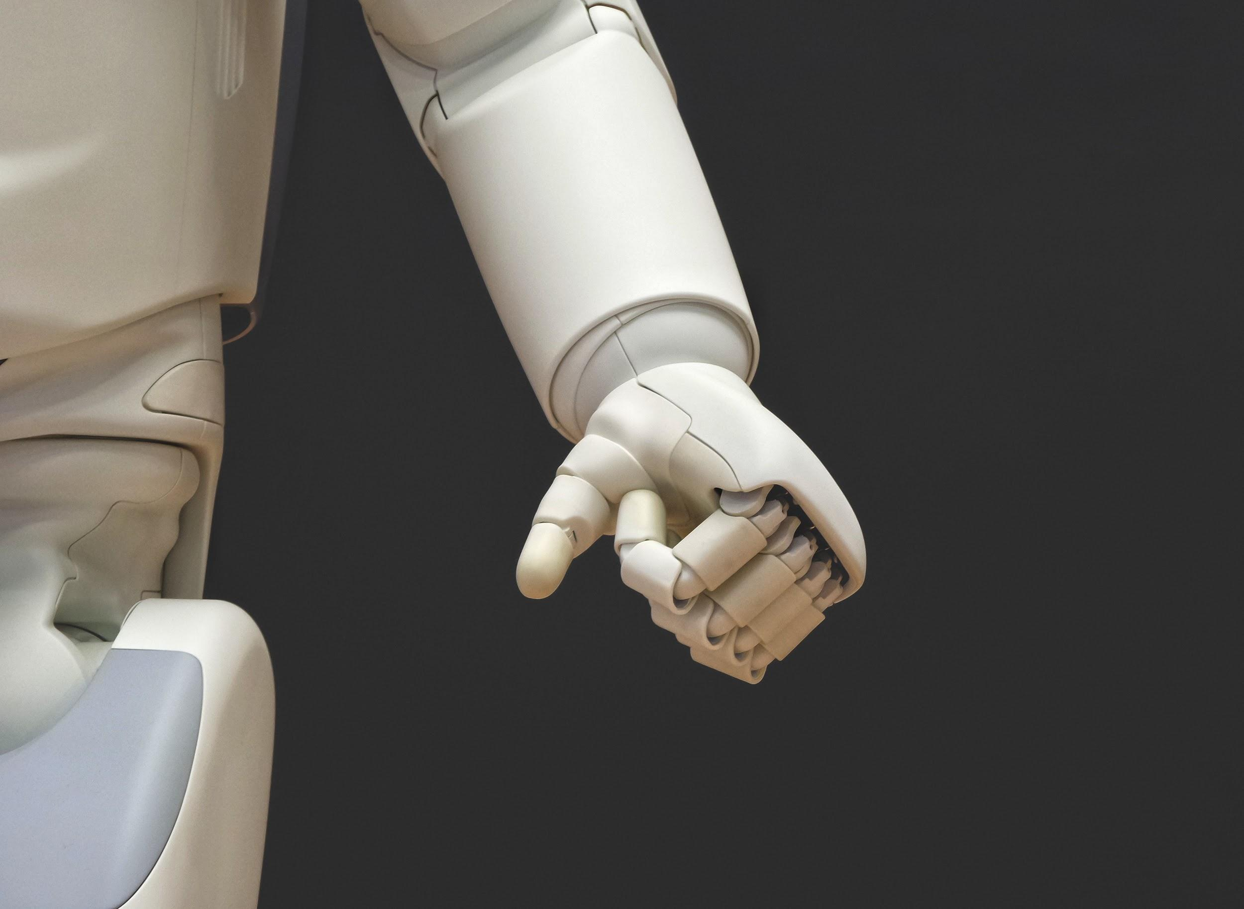
Autonomation is reducing human suffering but making more human jobs obsolete

Slide 3
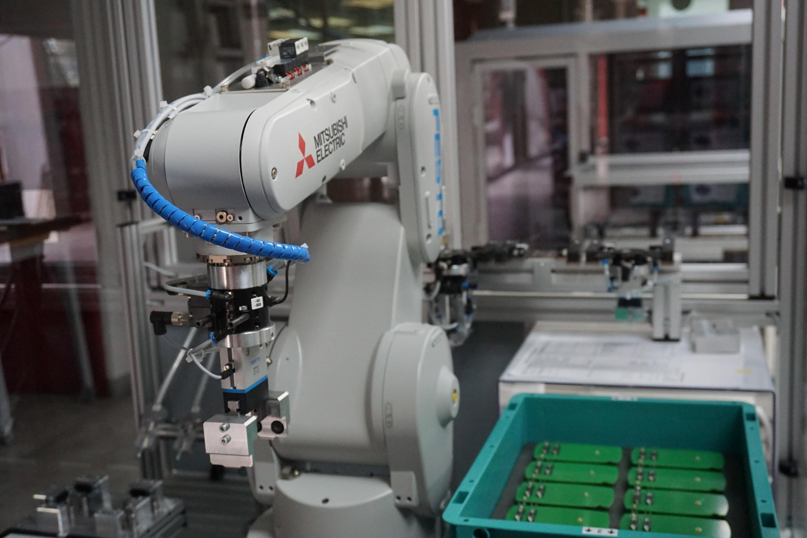
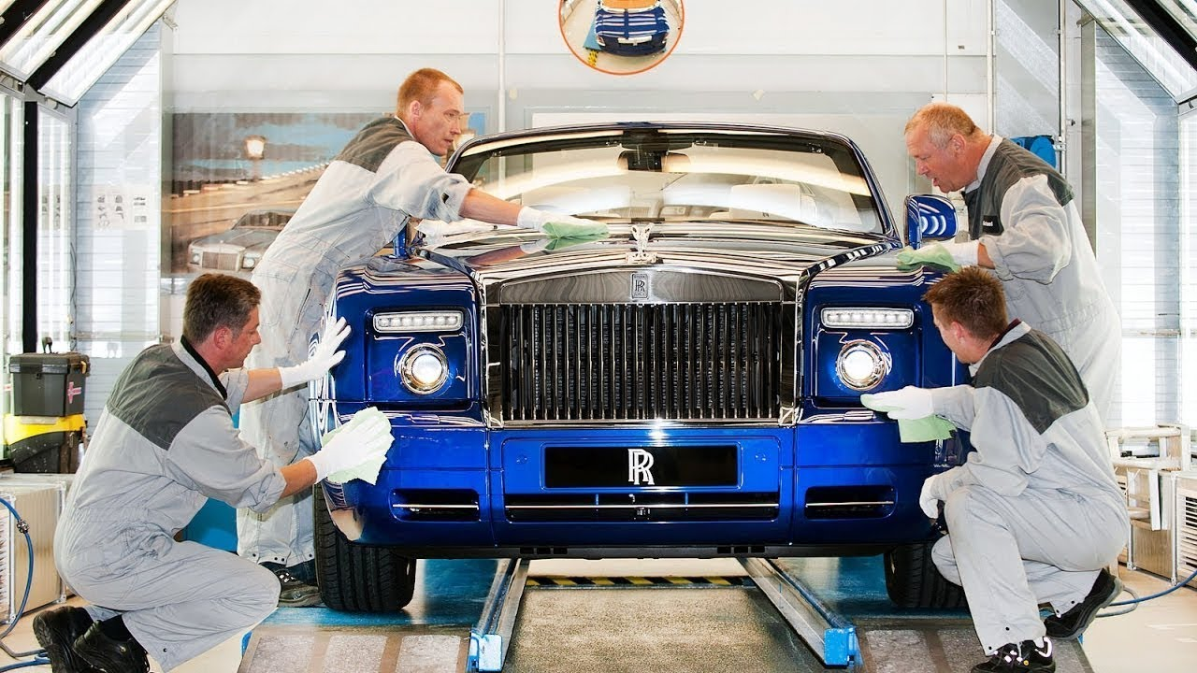
AU$86Bil per year spent globally on AI advancements.
Rolls Royce and high quality bespoke products still require humans.
Ethical toolkit

Slide 4
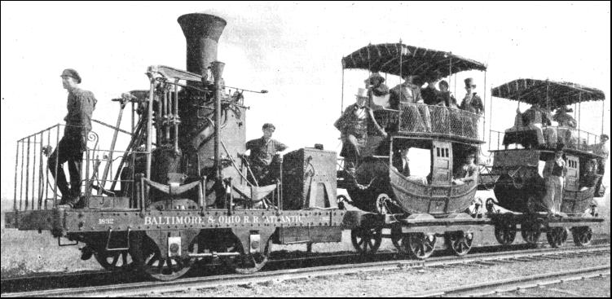
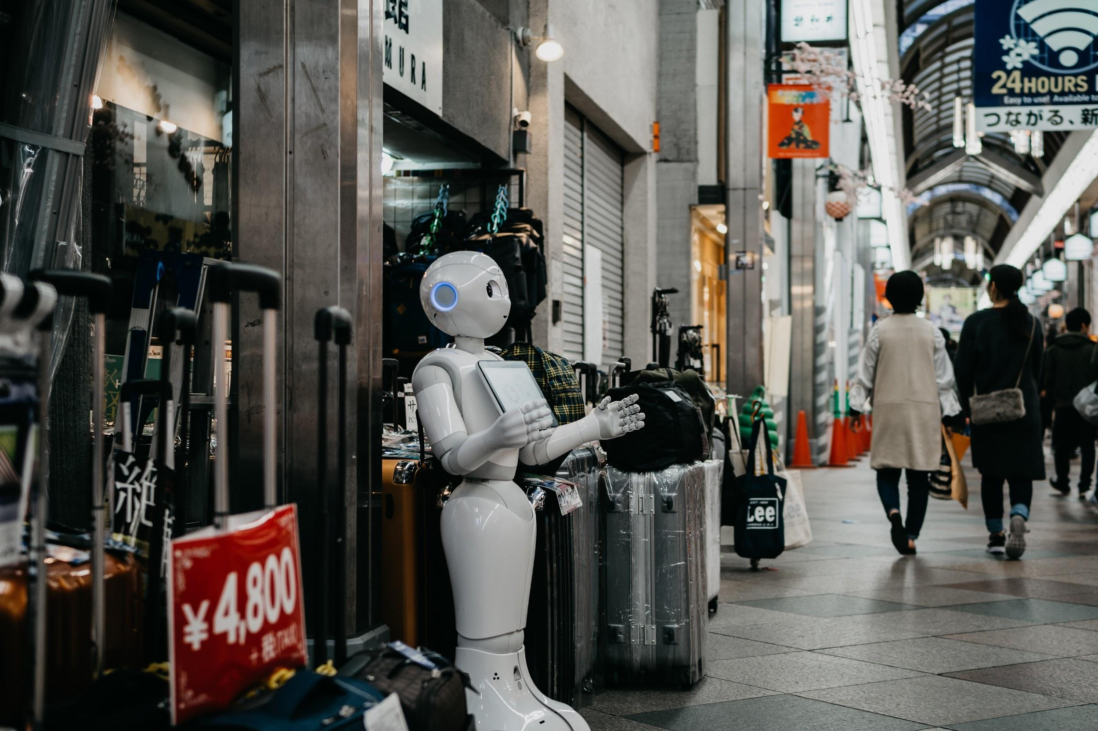
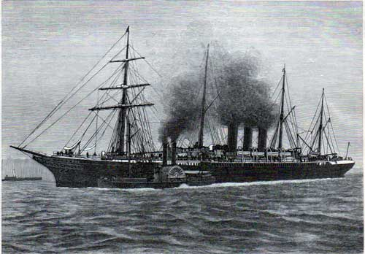
Recent advancement have led to clashes between the labour of human and robots. But attitudes around robotics are short terms and can’t see long terms societal advancement.

Slide 5
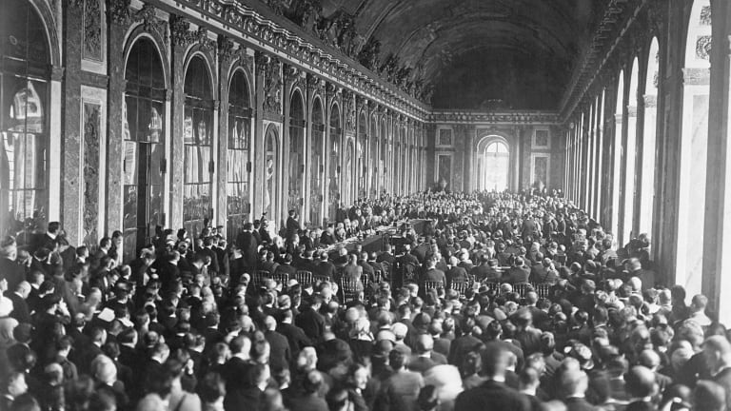
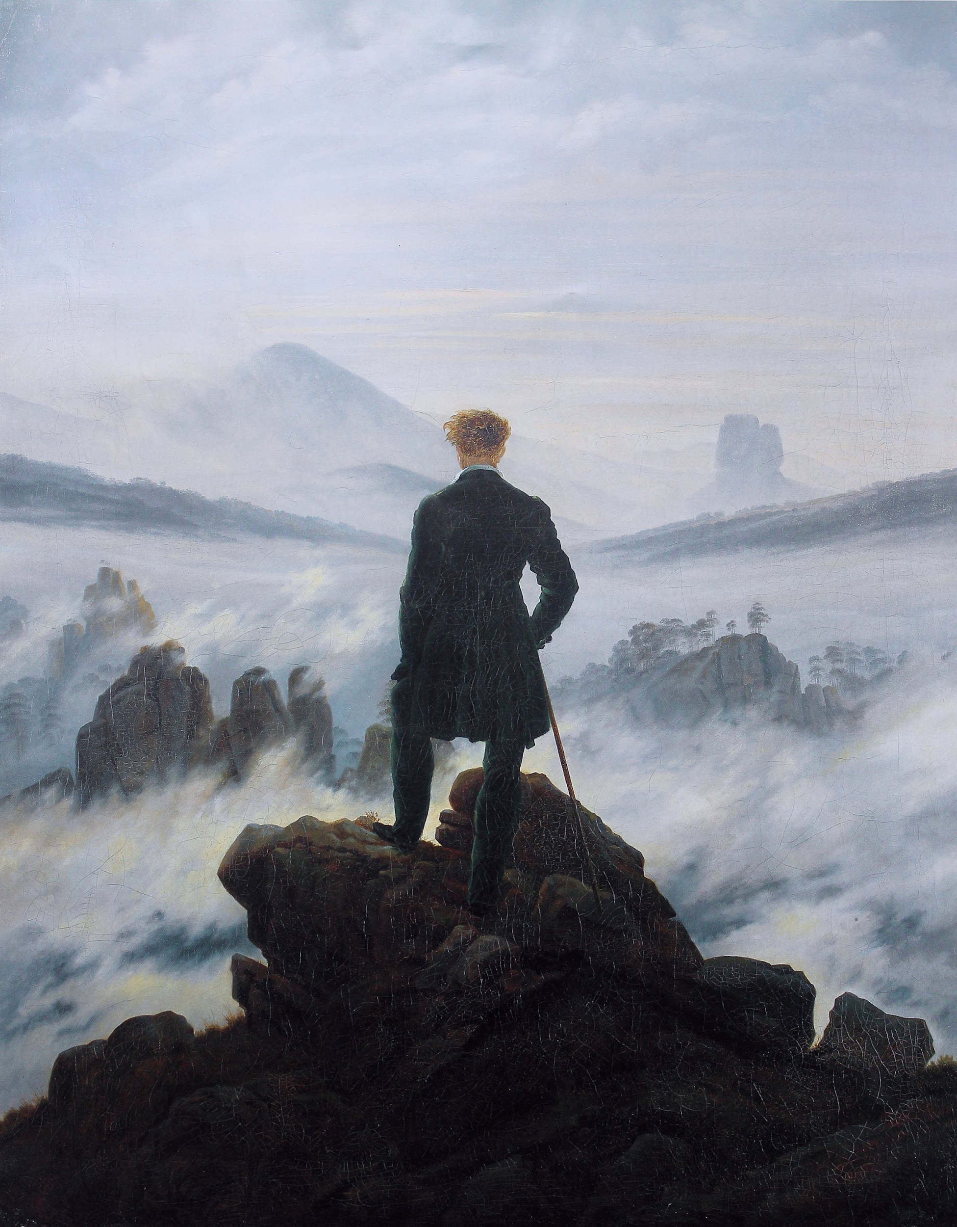
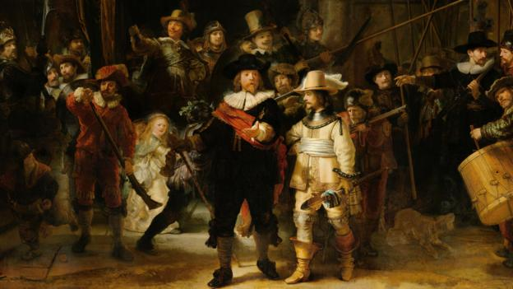
Stakeholders
Global Governments
Manufacturer
World leaders/Politicians
Individuals who are being replaced by technologies
The media

Slide 6

Target audience:
Young 16 to 22 (The future).
Working and Middle Class (Majority of potential job losses)
Communication channels
Youtube/Facebook
AU Ethical Automation Toolkit Discussion

